Slide 1
Maintenance Year 2
( continues)
Woodwork

Slide 2
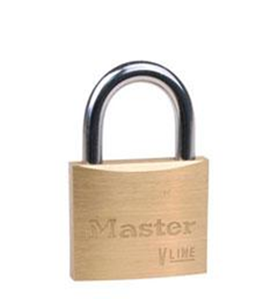
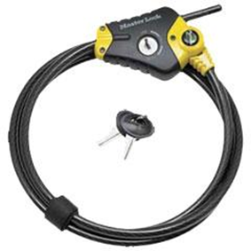
Basic locks.
Definition : A hinge is a moving joint
Different types of locks
1. Disc padlock
2. Cable lock

Slide 3
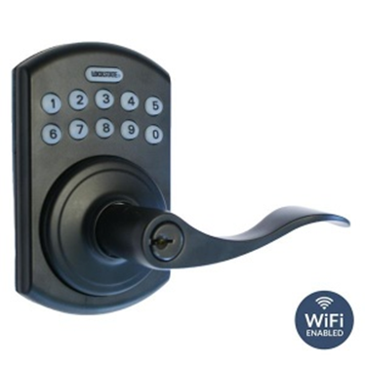
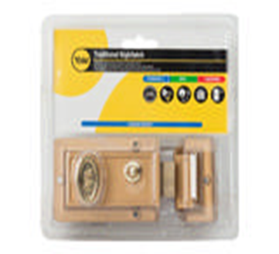
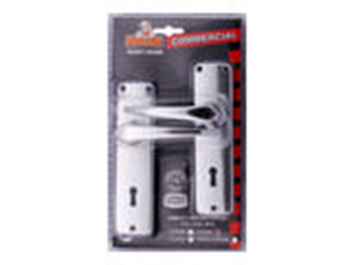
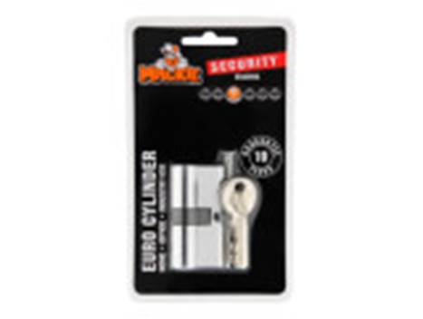
3. Remote lock
4. Night latch brass lock
5. Lever lockset
6. Cylinder lock

Slide 4
Adhesives
Definition : an adhesive substance used to stick objects or materiaals.
Different types of adhesive
Superglue
White glue or wood glue
General construction glue
Epoxies
Craft glue
Feedback
Activity : Worksheet 7

Slide 5
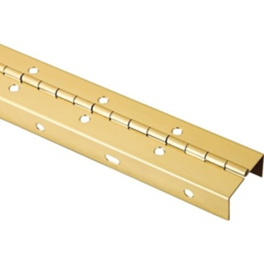
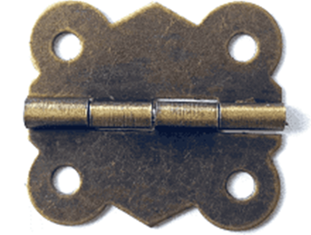
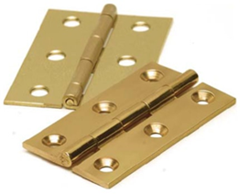
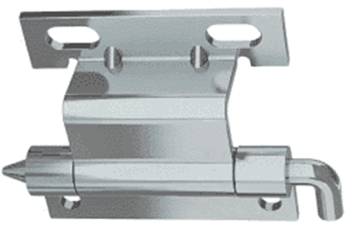
Kwa Thema Skills School
Subject : Maintenance Marks : 15
Grade : Year 2 Time : 30mins
Date :
Question:1
Name the following hinges.
1.__________________ 2.______________________
3.___________________ 4. ______________________

Slide 6
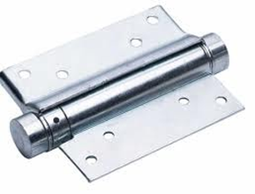
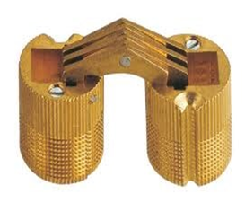
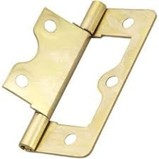
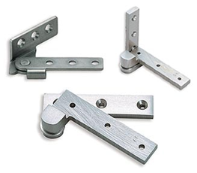
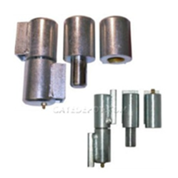
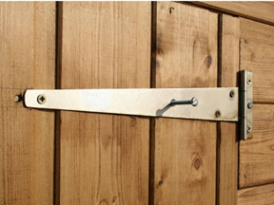
5. _________________ 6. ____________________
7. __________________ 8. ___________________
9. __________________ 10. ___________________
(10)

Slide 7
Question : 2
Name five types of adhesive
a. __________________
b. __________________
c. __________________
d. __________________
e. __________________
(5)

Slide 8

Feedback
Activity : Worksheet 8
Practical lesson or Project
Jewelry box

